Slide 1

BANKING CHURN PREDICTION
BY
SAKLAIN SHEIKH
BABIES A
RAKSHITHA INDUKURI
JESWIN J C

Slide 2
1.Problem Statement
6.Predictive Modelling
2.Data Mining
DATA SCIENCE CYCLE
5.Feature Engineering
3.Data Cleaning
4.Data Exploration

Slide 3
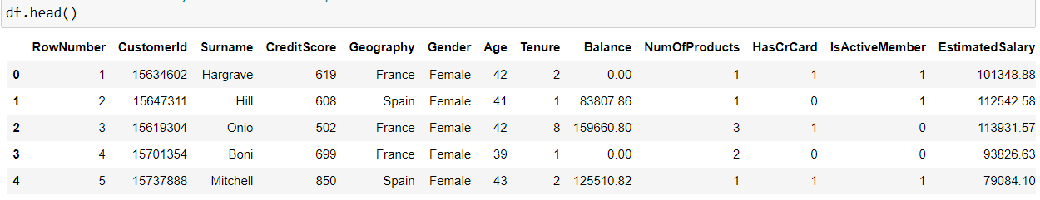
Attribute Information
PROBLEM STATEMENT
Row number: The number of the row
Customer ID: Unique ID of the customer
Surname: Customer Name
Credit Score: Their credit score
Geography: Which country they belong to
Gender: Male , Female or Others
Age: Age of the customer
Tenure: The time of bond with the company
Balance: The amount left with them
Num Of Products: The products they own
Has Cr Card: Do they have credit card or not
Is Active Member: How active member they are
Estimated Salary: Their estimated salary
Exited: Whether they Stay or Leave
The data set contains details of a bank's customers and the target variable is a binary variable reflecting the fact whether the customer left the bank (closed his account) or he continues to be a customer.
df.shape()=(10000,14)

Slide 4
OBJECTIVES
The goal is to develop a machine learning model for Bank Churn Prediction using various supervised machine learning classification models and predicting results in the form of best accuracy by comparing supervised algorithms
PROPOSED SYSTEM
The proposed method is to build a Bank customer Churn Prediction using Machine Learning Technique . We are going to develop a AI based model , we need data to train our model . We can use bank customer dataset in order to train the model . To use this dataset , we need to understand what the intents that we are going to train are . An intent is the intention of the user interacting with a predictive model or the intention behind each data that the model receives from a particular user .

Slide 5


Slide 6
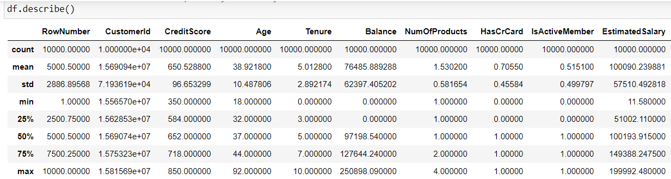
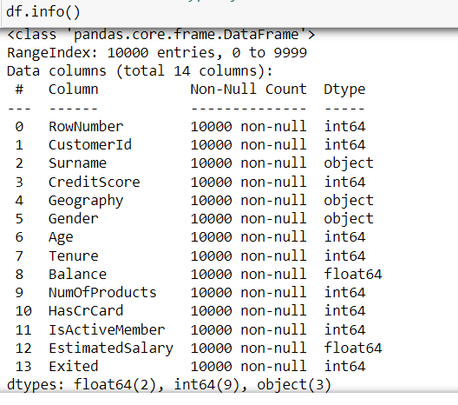
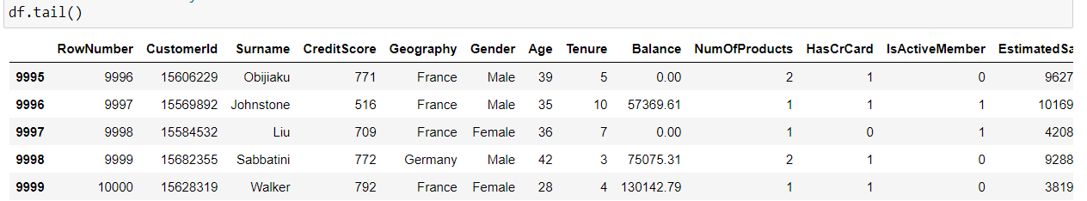
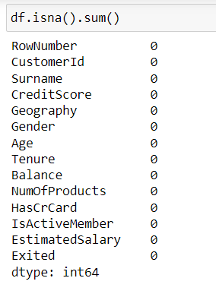
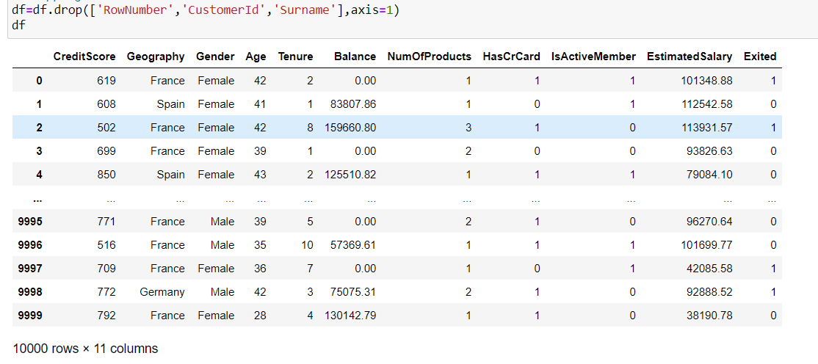


Slide 7


Slide 8
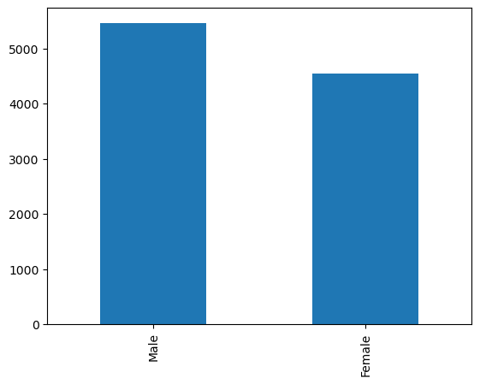
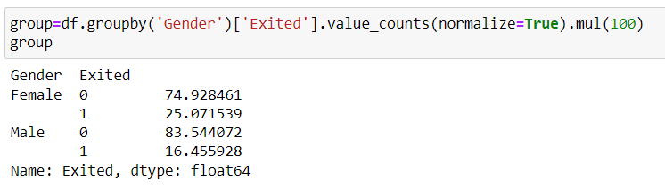
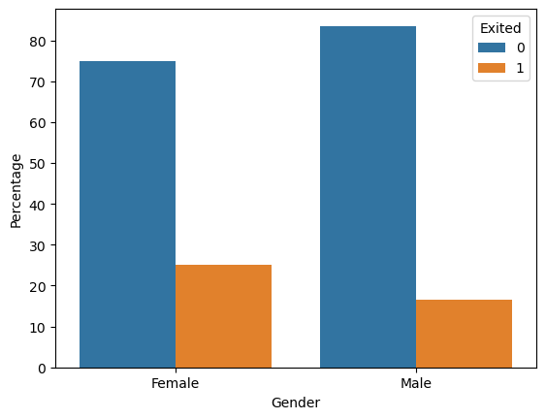
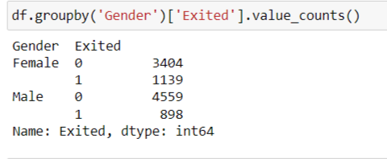
ANALYSIS IN GENDER

Slide 9
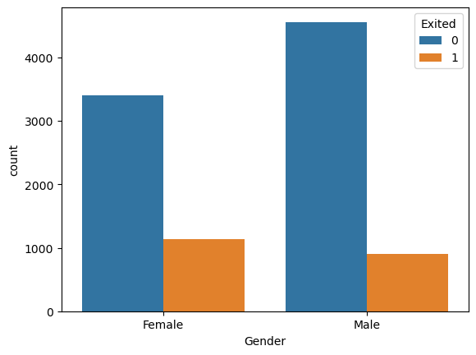
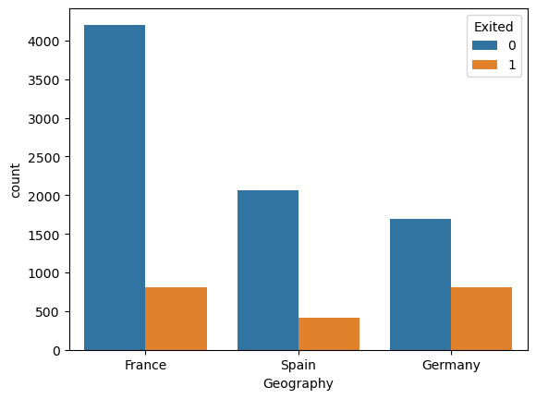
CATEGORICAL VARIABLE

Slide 10
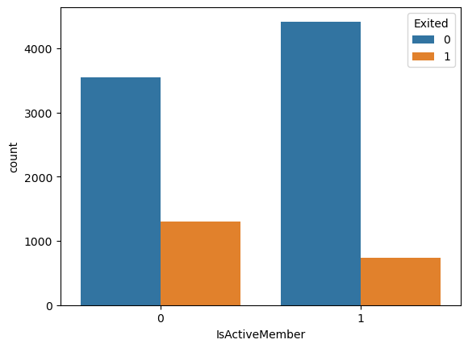
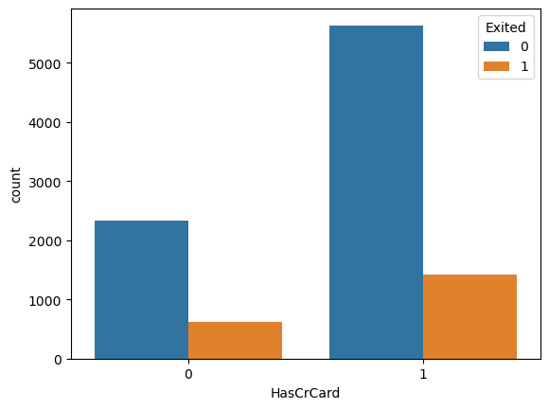

Slide 11
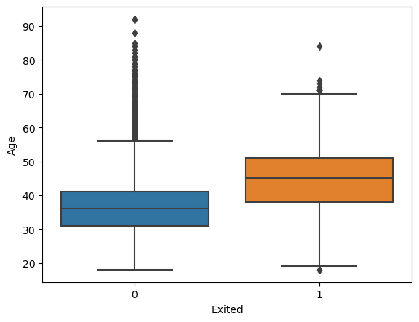
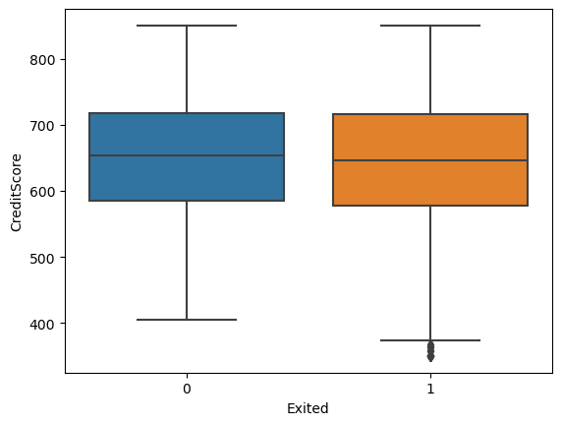
CONTINUOUS VARIABLE

Slide 12
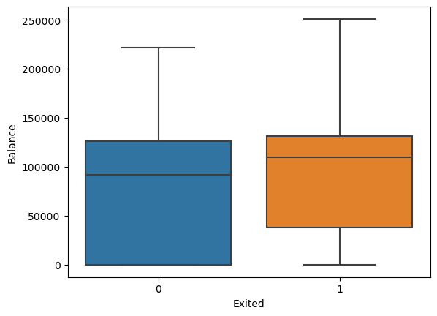
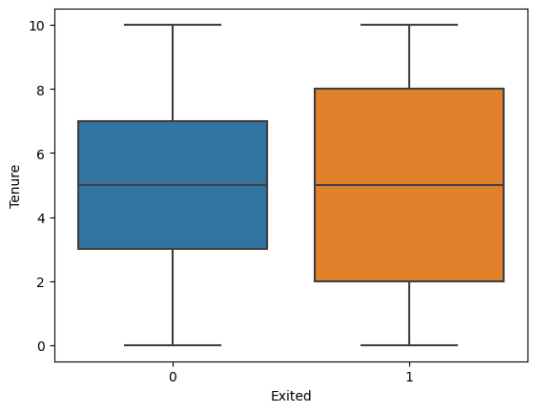

Slide 13
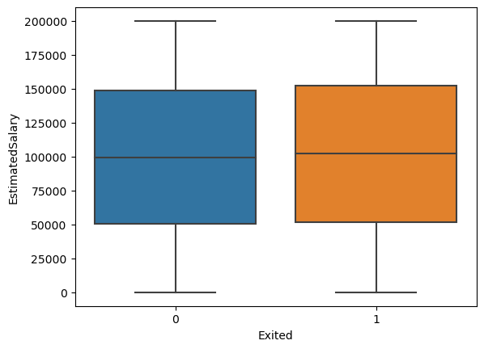
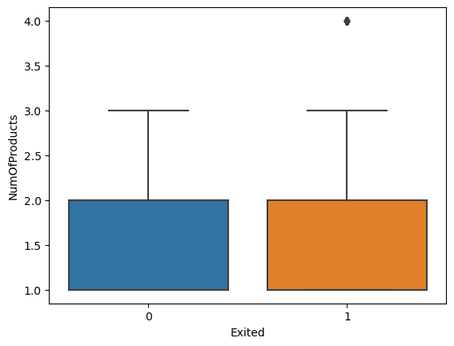

Slide 14
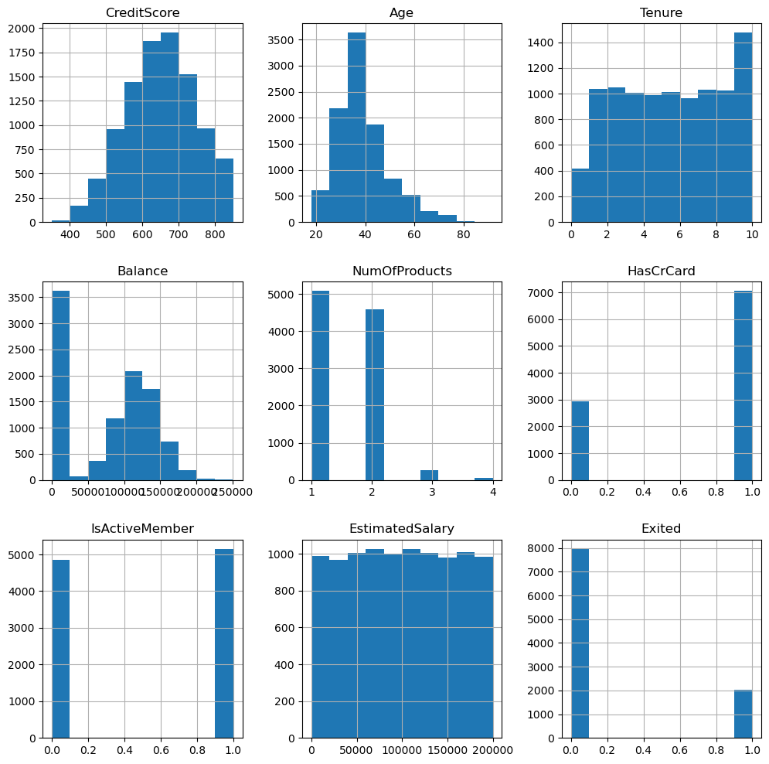
HISTOGRAM

Slide 15
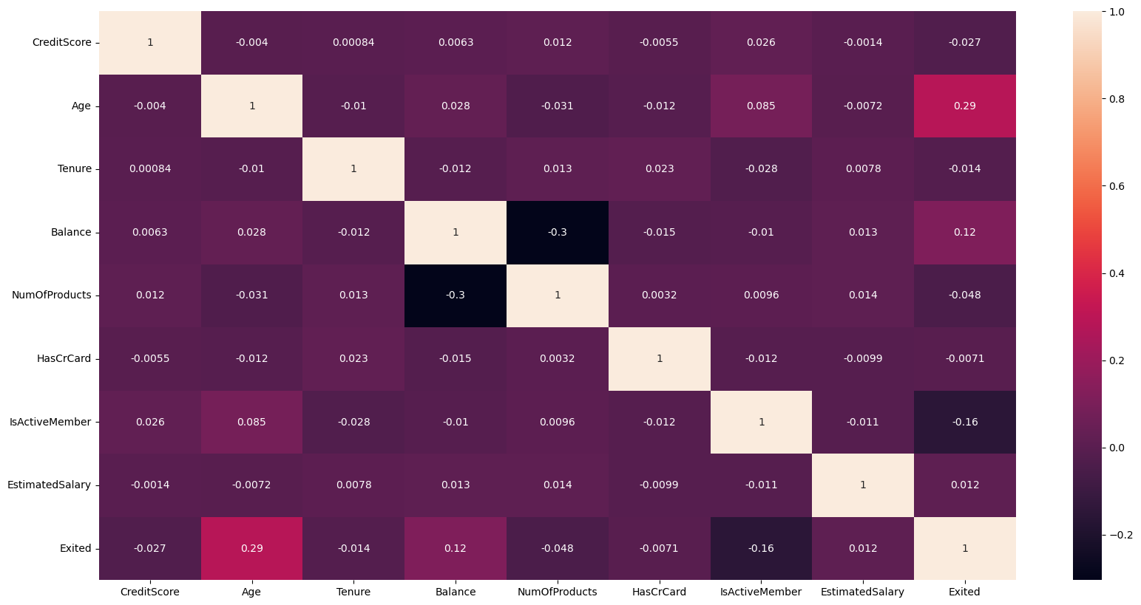
HEAT MAP

Slide 16
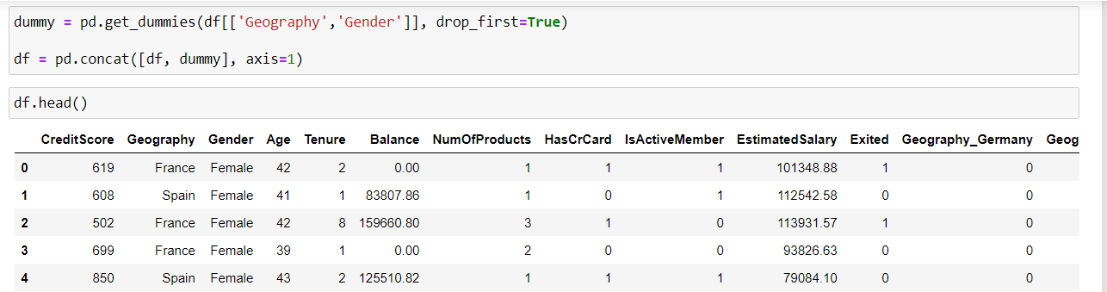
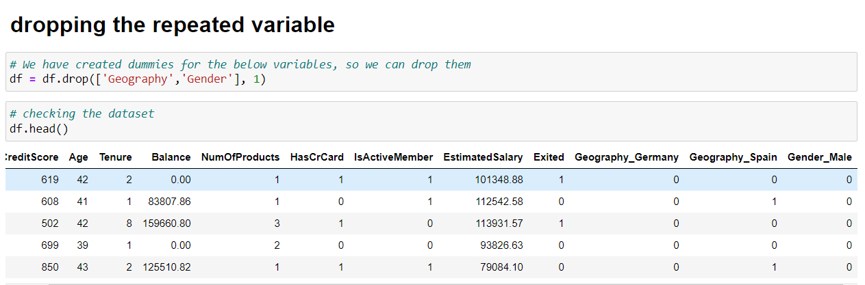
FEATURE ENGINEERING

Slide 17
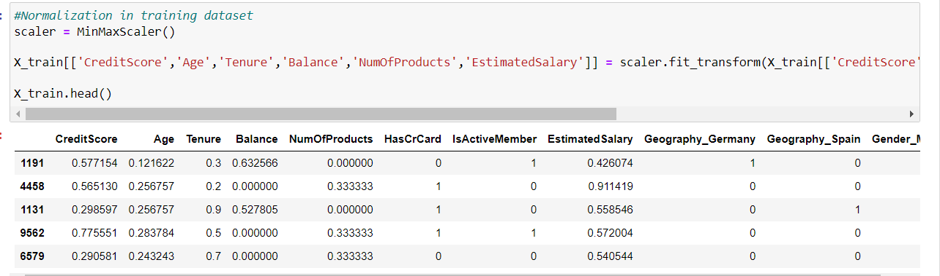
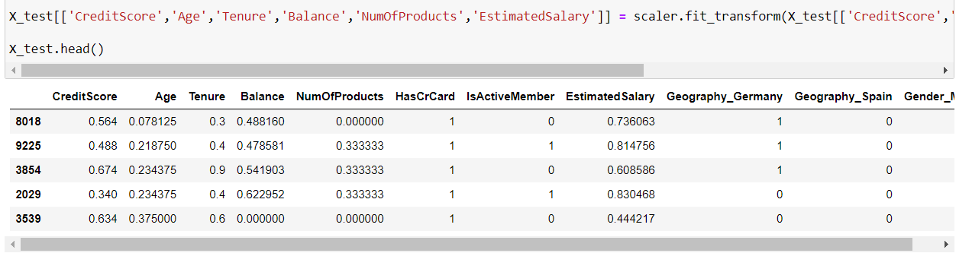
DATA TRANSFORMATION

Slide 18


Slide 19
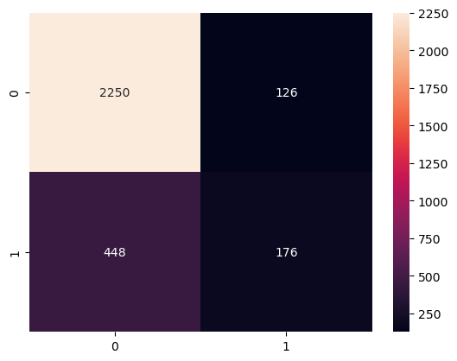
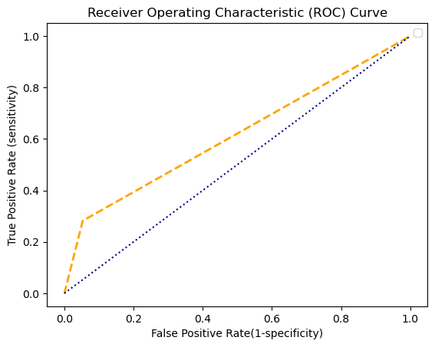
LOGISTIC REGRESSION
Library used : sklearn.linear_model(LogisticRegression)
Split used for training and testing data:70,30
Accuracy: 80.87
Sensitivity:83.40
Specificity:58.28
Precision:94.70
Recall:83.40
F-Score:88.69
AUC:61.45

Slide 20
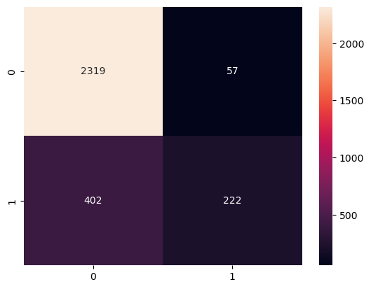
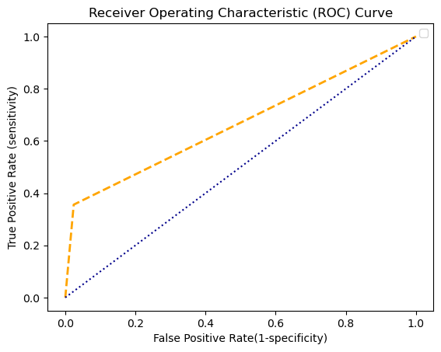
SUPPORT VECTOR MACHINE
Library used:sklearn.svm(SVC)
Split used for training and testing data:70,30
Accuracy:84.7
Sensitivity:85.23
Specificity:79.57
Precision:97.60
Recall:85.23
F-Score:90.99
AUC:66.59

Slide 21
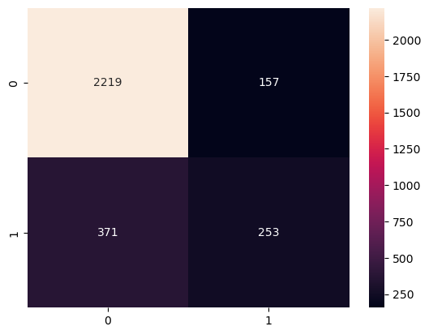
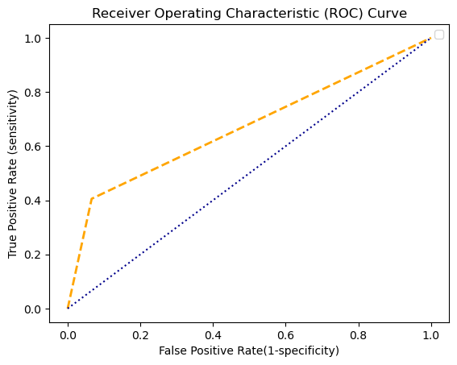
NAIVE BAYES ALGORITHM
Library used:sklearn.naive_bayes( GaussianNB)
Split used for training and testing data:70,30
Accuracy:82.4
Sensitivity:85.67
Specificity:61.71
Precision:93.39
Recall:85.67
F-Score:89.37
AUC:66.97

Slide 22

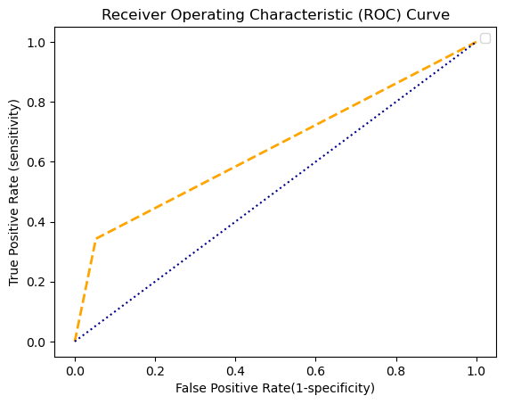
KNN-k nearest neighbour
Library used : sklearn.neighbors (KNeighborsClassifier)
Split used for training and testing data:70,30
Accuracy:82.17
Sensitivity:84.59
Specificity:63.13
Precision:94.74
Recall:84.59
F-Score:89.38
AUC:64.52

Slide 23
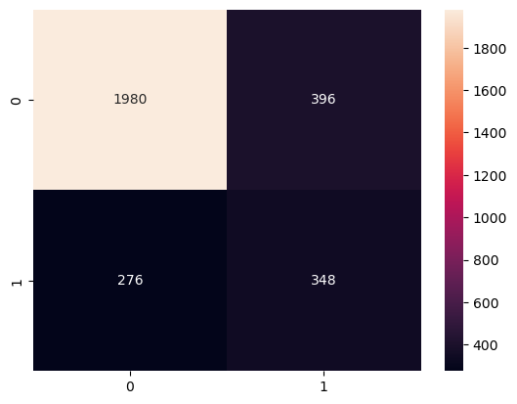
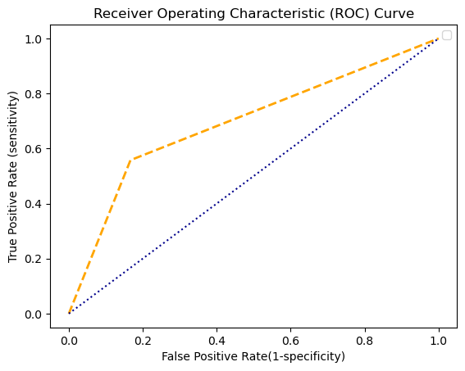
DECISION TREES
Library used : sklearn.tree (DecisionTreeClassifier)
Split used for training and testing data:70,30
Accuracy:77.6
Sensitivity:87.76
Specificity:46.77
Precision:83.34
Recall:87.76
F-Score:85.49
AUC:69.55

Slide 24

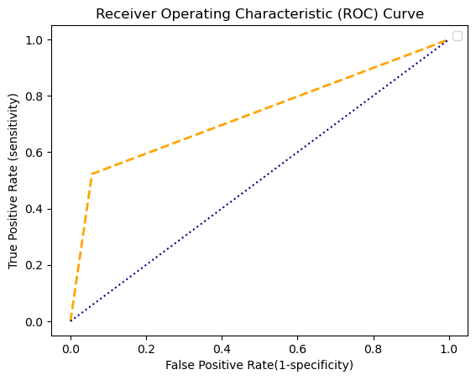
RANDOM FOREST
Library used : sklearn.ensemble (RandomForestClassifier)
Split used for training and testing data:70,30
Accuracy:85.57
Sensitivity:88.26
Specificity:70.72
Precision:94.32
Recall:88.26
F-Score:91.19
AUC:73.28

Slide 25
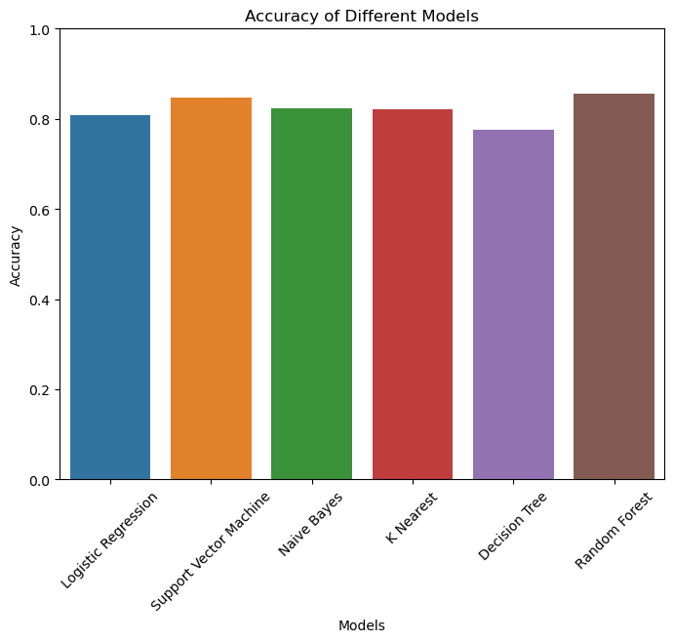
ACCURACY COMPARISON
Random forest has the highest accuracy among all the models which is 85.57%

Slide 26

SAKLAIN SHEIKH
saklainsheikh@gmail.com
EBEON0323753814
BABIES A
babiesalex48@gmail.com
EBEON0423739483
RAKSHITHA INDUKURI
rakshithaarskshu@gmail.com
EBEON0423720669
JESWIN J C
jeswinmaria98@gmail.com
EBEON0323783066

